Slide 1
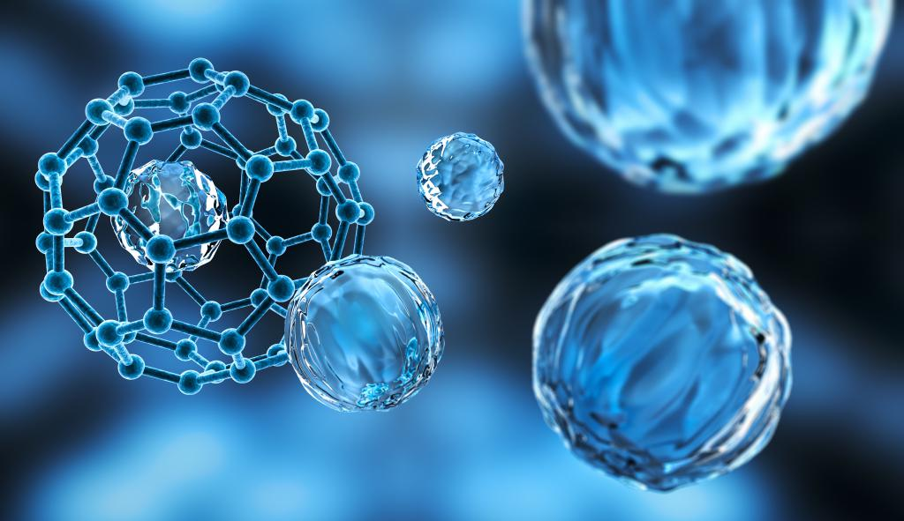
Nanotechnology
Nanomaterials, properties and fabrication
ATAR Chemistry Unit 1, 2021

Slide 2
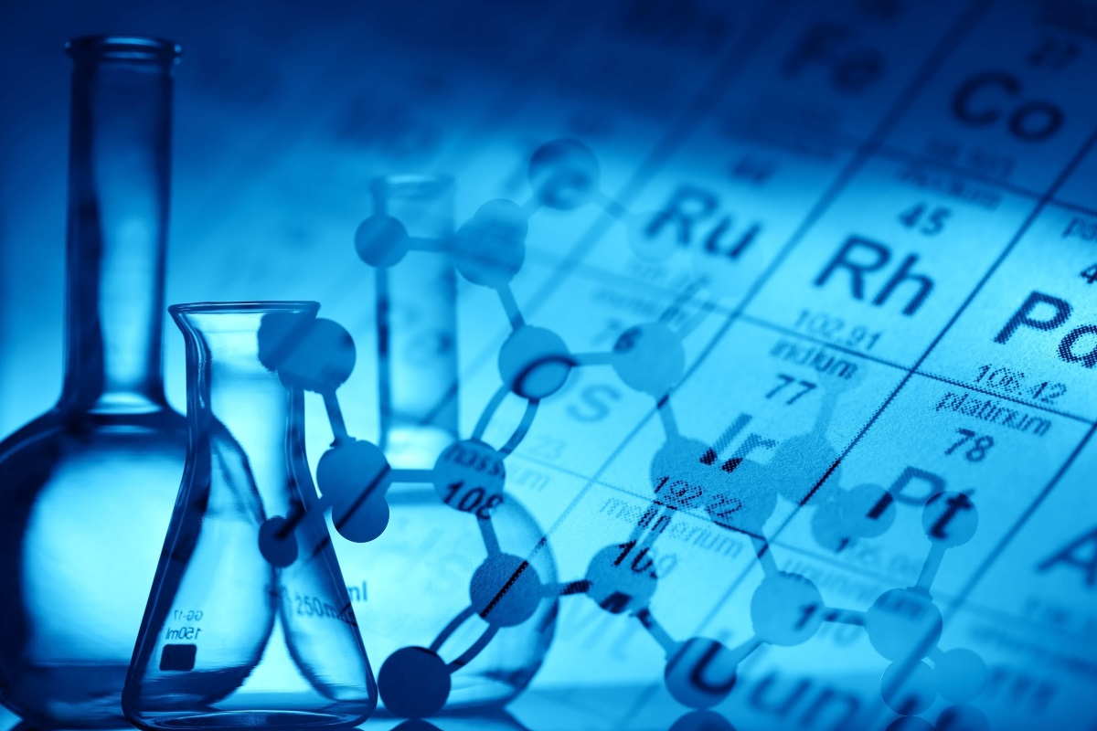
Outline
Nanotechnology
Nanoscale
Nanomaterials
Fabrication
Nanoparticles
Risks to health and environment

Slide 3
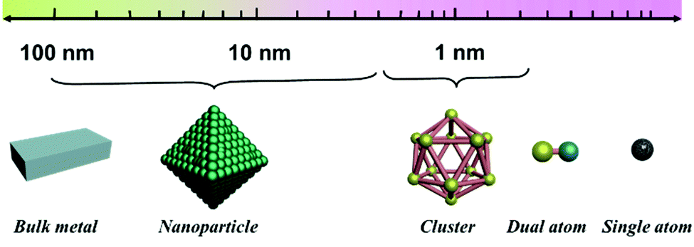
Nanotechnology
Traditionally chemistry focused on the structures of atoms and the properties of bulk materials.
Nanotechnology occurs between these two extreme sizes; they are larger than atoms but smaller than a wavelength of light (thus making them invisible to the naked eye and even to the most powerful optical microscopes)

Slide 4
Nanotechnology
On this scale, surface area to volume ratio changes allowing surface area effects, called quantum effects, to become more evident.
Nanomaterials have unique properties, broadly classified into
physical properties (strength, density, flexibility),
optical properties,
electrical properties,
catalytic properties.

Slide 5
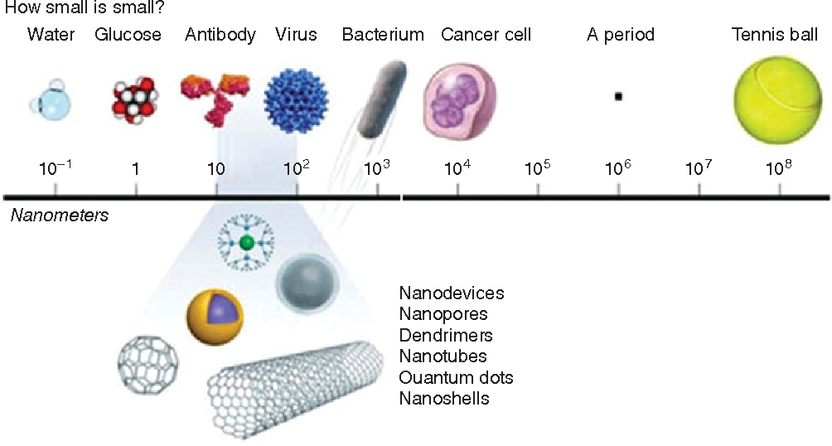
Nanoscale
Nanoscale refers to structures between 1 and 100 nanometres
A nanometer is 10⁻⁹ m (one billionth of a metre) and has the symbol nm
Studying and working at this scale is very difficult
1980s scientists developed atomic force microscopy and scanning tunneling microscopy; allowing them to view and manipulate individual atoms and nanomaterials
https://www.youtube.com/watch?v=OFWNHTIm_O8

Slide 6
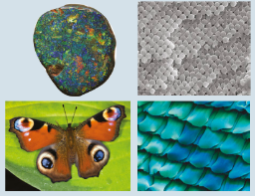
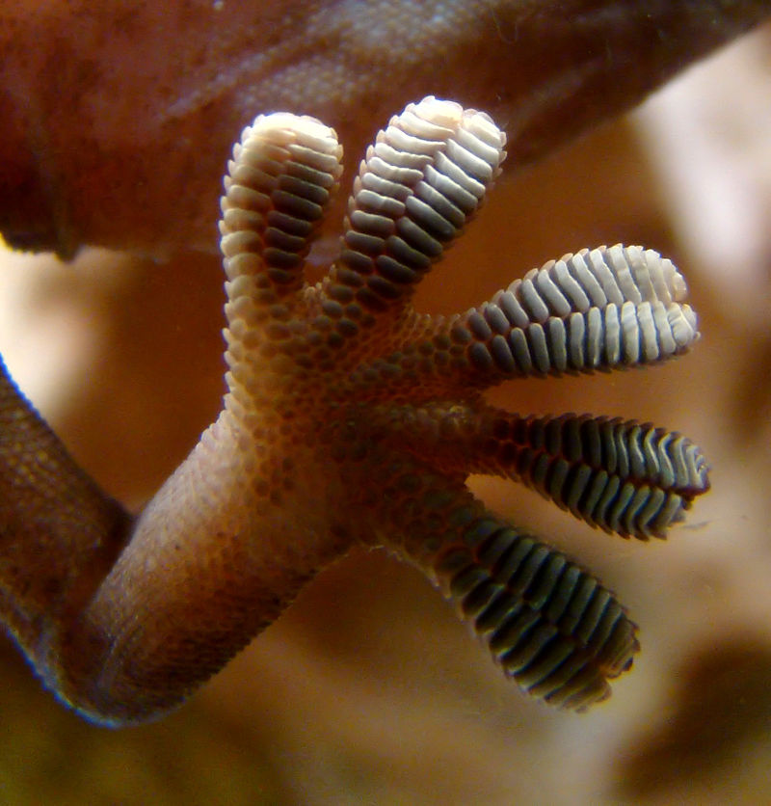
Nanomaterials
The are natural and synthetic nanomaterials
They are composed of single units that exist in the nanoscale
Natural examples include: spider silk, colour of butterfly wings, bottom of gecko feet, opals and fullerenes (such a bucky balls that occur naturally in soot).
Synthetic examples also include fullerenes and carbon nanotubes (both will be covered in detail later in the course)

Slide 7
Nanomaterials
Fabrication overview
Top-down fabrication
Bottom-up fabrication
Start atom level SMALL
Start BIG
Either selectively remove material or size of the material is progressively reduced
E.g grinding
Adv – good uniformity, cheaper
Disadv – resisted to simple structures
A lot like chemical synthesis but on nanoscale
E.g precipitation and self-assembly
Adv – make more complex structure
Disadv – more expensive, smaller scales

Slide 8
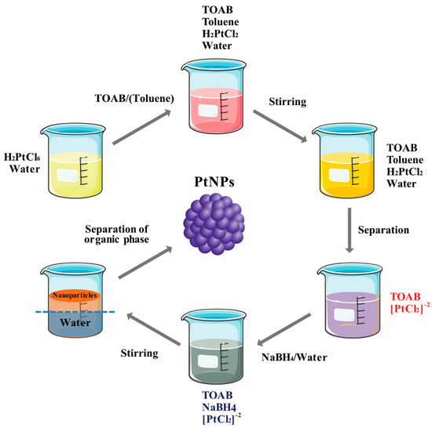
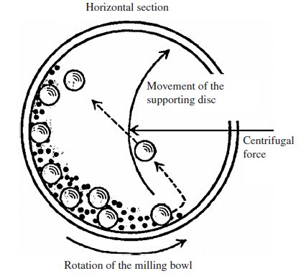
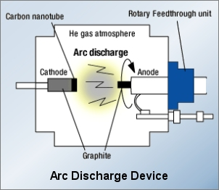
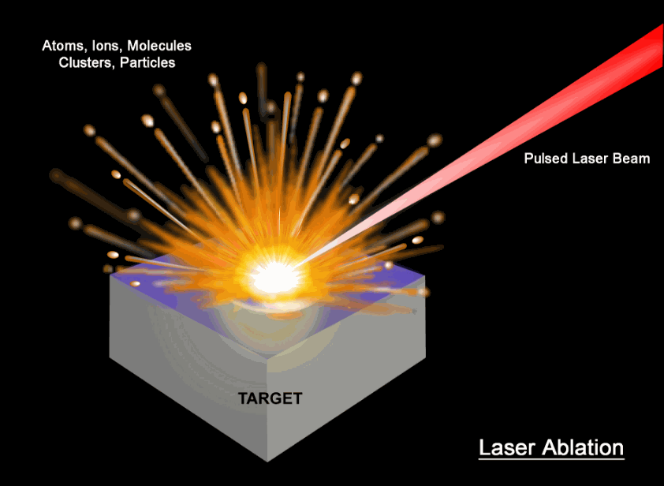
Nanomaterials
Fabrication examples
solution evaporation
Chemical vapour deposition
Microbial synthesis
Chemical precipitation
Grinding
Electric arc discharge
Laser ablation
used to make TiO₂ and ZnO for sunscreen
common technique to make carbon nanotubes
high power laser to vaporize graphite

Slide 9
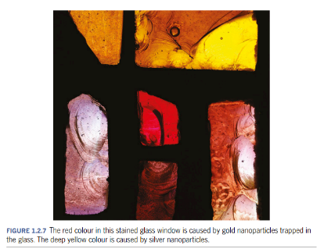
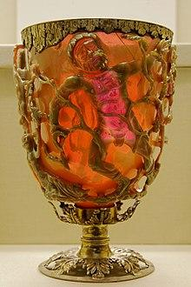
Nanoparticles
Nanoparticles are a specific type of nanomaterial
Generally spherical particles with diameters between 1 – 100 nm
Have applications in medicine, physics, optics and electronics
Interesting properties of nanoparticles have been exploited for hundreds of years
The Lycurgus cup
4th century Roman cup
Changes colour
Dichroic effect caused by gold and silver nanoparticles embedded in the glass

Slide 10
Properties of nanomaterials
Nanoparticle can have unique properties such as:
Physical properties (such as strength, weight, and flexibility)
Optical properties
Catalytic properties
Electrical properties

Slide 11
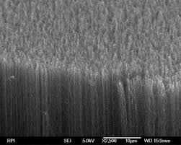
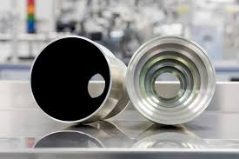
Properties of nanomaterials
optical properties
Some nanomaterials have interesting optical properties, here are some examples:
Vantablack – a paint that absorbs 99.965% of visible light. Made of carbon nanotubes which are carefully aligned in the same direction. Light can enter between the nanotubes but becomes trapped and eventually the light energy is dissipated as heat.

Slide 12
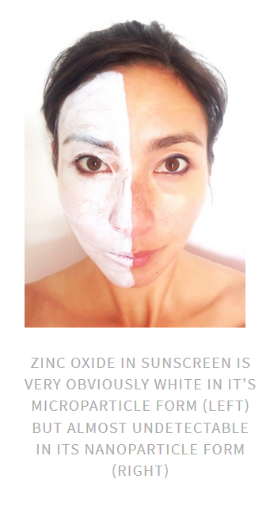
Properties of nanomaterials
optical properties
Zinc oxide and titanium oxide nanoparticles – zinc oxide and titanium oxide provide excellent protection from UV radiation. Both are white opaque solids that in their macro particle form are used in many sunscreens and cosmetics, unfortunately in this larger form they remain visible on skin. By using the smaller nanoparticles, they retain their UV protective properties but become transparent and colourless; so they form an invisible coating on skin.

Slide 13
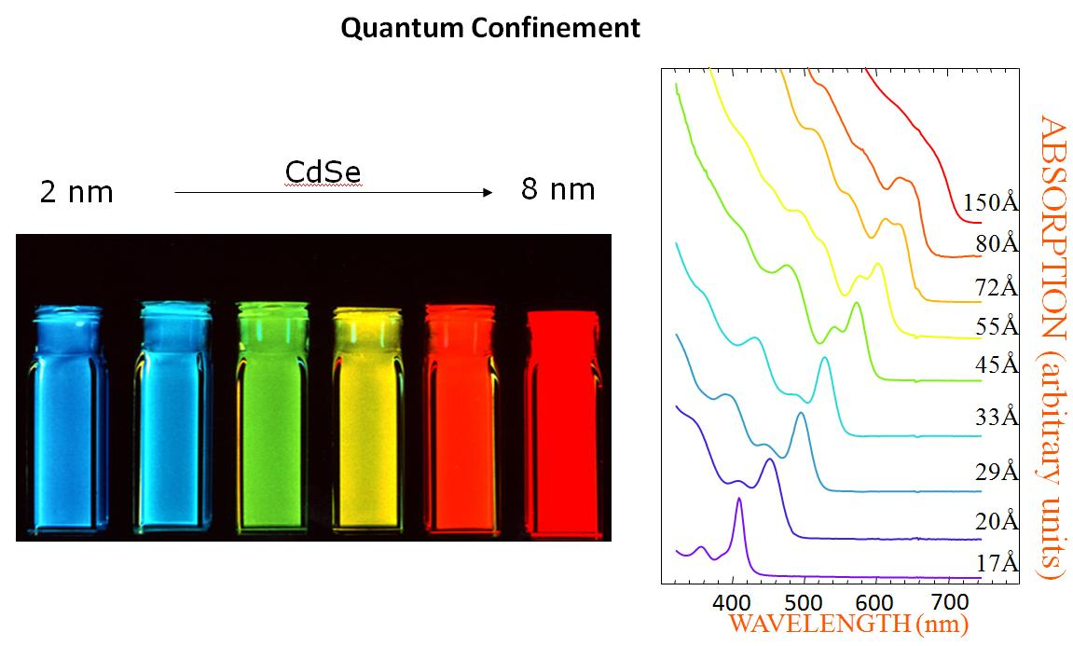
Properties of nanomaterials
optical properties
Quantum dots –
e.g. cadmium selenide, CdSe. The colours vary (when exposed to UV light) due to the different size range from 2-10 nanometres.
Applications: biological tracers, solar cells They also have interesting electrical properties.
also be made of ZnS, ZnSe, CdSe and so on.

Slide 14
Properties of nanomaterials
electrical properties
Some nanomaterials have interesting electrical properties, here are some examples:
Carbon nanotubes – have quite different patterns of conductivity to graphite. Depending on their dimensions and symmetry, CNTs can be excellent conductors of electricity or semiconductors. Possible applications to use CNT to create nano-sized transistors and diodes.
Standford University reported in 2013 the first computer made entirely of carbon nanotubes. It was a basic device but serves as proof of concept for the use of CNTs in this way. They will potentially be smaller than current silicon-based components and more efficient, making computers smaller, faster and more energy efficient.

Slide 15
Properties of nanomaterials
medical properties
Some nanomaterials have interesting applications in medicine.
Silver: silver has antibacterial and antifungal effects due to the release of silver ions from the surface. Using nanoparticles of silver vastly improves these effects due to the huge increase in surface area. Nanosilver is now being incorporated into a large number of commercial products, including: surgical badges, plastic containers and cosmetics (see the next slide for a number of examples)
This indiscriminate use has led many to question the safety of unregulated nanomaterials in products – primarily their health and environmental hazards

Slide 16
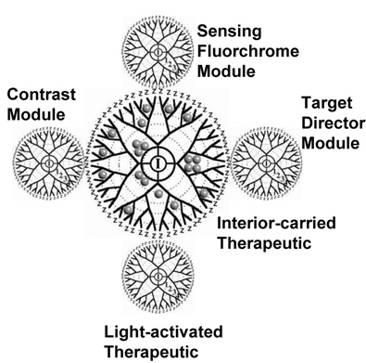
Properties of nanomaterials
medical properties - nanodevices
Nanodevices research – in the field of medical detection, diagnosis and treatment of disease, especially cancer.
E.g. nanodevice is one based on dendrimers that act as molecular carries. They transport smaller molecules – such as molecules that can recognise cancer cells, therapeutic agents and molecules that can signal the cancer cell’s death.
As the dendrimer device would only accumulate in cancers cells it would reduce side effect and enhance treatment efficiency.

Slide 17
Nanocomposites
Nanocomposites – materials that contain nanoparticles embedded in a matrix of a bulk material such as metals, polymers and ceramics (e.g. concrete)
Example 1: carbon black added to rubber. The carbon nanoparticles improve the electrical conductivity of the rubber. This presents the build up of static electricity on the surface of vehicle tires (really important for fuel trucks!)
Example 2: a carbon-silicon nanocomposite that may be used to replace brittle, graphite electrodes in lithium ion batteries.

Slide 18
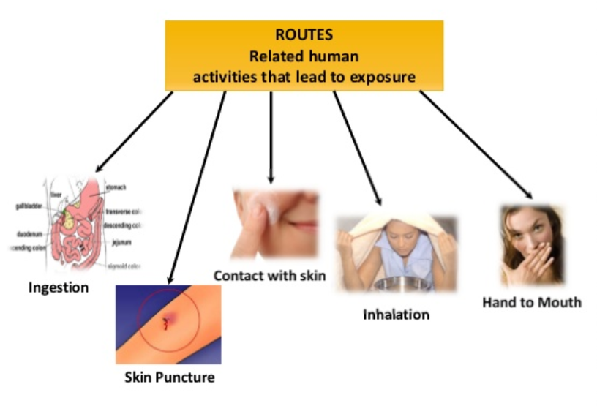
Safety
A lot of research has been done on the health and environmental effects on bulk materials. So, what about nanomaterials? They have vastly different properties to their bulk counterparts – do they pose a risk to safety (environmental and health)?

Slide 19
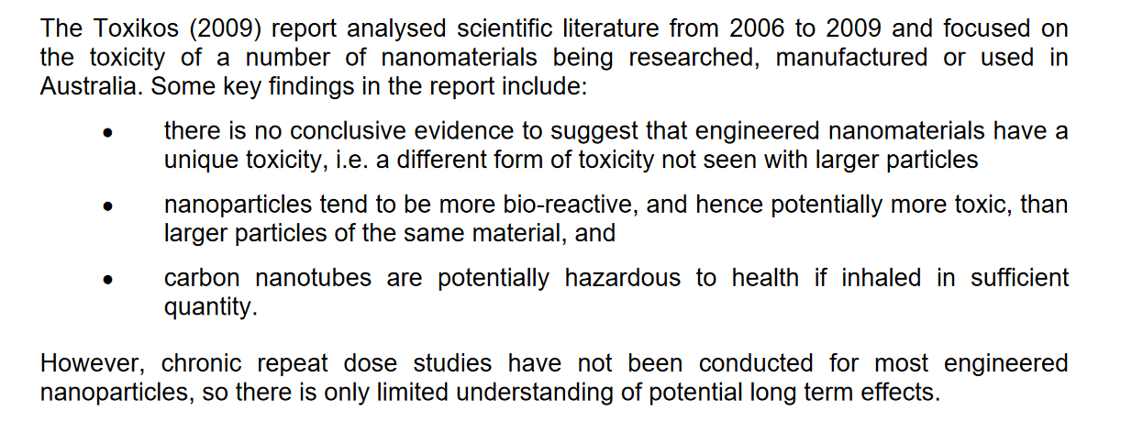
Safety
https://www.safeworkaustralia.gov.au/system/files/documents/1702/engineered_nanomaterials_feasibility_establishing_exposure_standards_august_2010.pdf

Slide 20
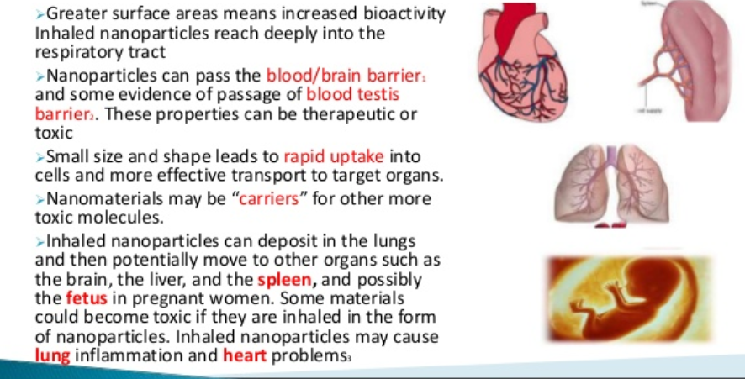
Safety

Slide 21
Where to next…
A boy and his atom
https://www.youtube.com/watch?v=oSCX78-8-q0

